Slide 1
Major Project Title:- Live Covid-19 Tracker
RAJAT MITTAL
B.Tech. CSE 8th Semester
Enrollment No. – 16AU/665
Roll No- 2087313

Slide 2
Presentation Outlines
Introduction
Objectives
Technologies used
System Requirements
Implementation
Application Snapshots
Future Work
Conclusion

Slide 3
Introduction
This presentation is the project for live tracking of cases of the pandemic COVID – 19. In this way, this project is a good initiative towards our society.
This project is hosted on a website named as https://rajatenzyme.github.io/covid/
User can easily visit this website using basic internet connection. Whenever user will request the homepage of the website, it will automatically fetch the data from different APIs. This data will be fetched from two different APIs – one for the World Countries and other for Indian states. In this data, Total Confirmed, Total Recovered, Total Deaths, New Confirmed, New Recovered, New Deaths etc. will be there.

Slide 4
Objectives
The objective for this project is to convey the information of COVID – 19 cases to everywhere in the world. So, people can understand the seriousness of situation.
Cases are increasing exponentially in the whole world. Still, most of the population is unaware/irresponsible of the situation.

Slide 5
Technologies used
API
HTML,
CSS
Bootstrap
JQuery
JavaScript

Slide 6
System Requirements
Hardware requirements:
A device connected to internet
Software Requirements
Operating System
An IDLE
Web Browser

Slide 7
Implementation
Implementation of this project has been done in two parts:
Website Designing ( Front – End Development)
API Calling
Website Designing part has been done using HTML, CSS, Bootstrap and some JavaScript.
Whenever user refreshes/opens the homepage, two different APIs (https://api.covid19api.com/summary - WORLD DATA
https://api.covid19india.org/data.json - INDIA DATA)
it will automatically fetch the data from both the APIs.

Slide 8
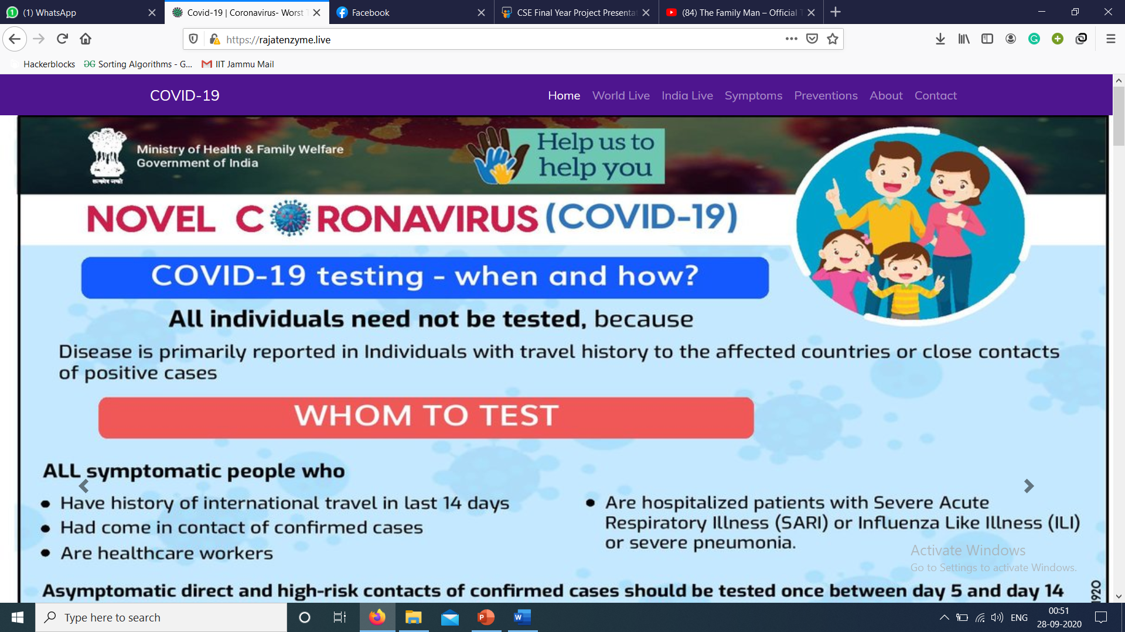
Application Snapshots Homepage

Slide 9
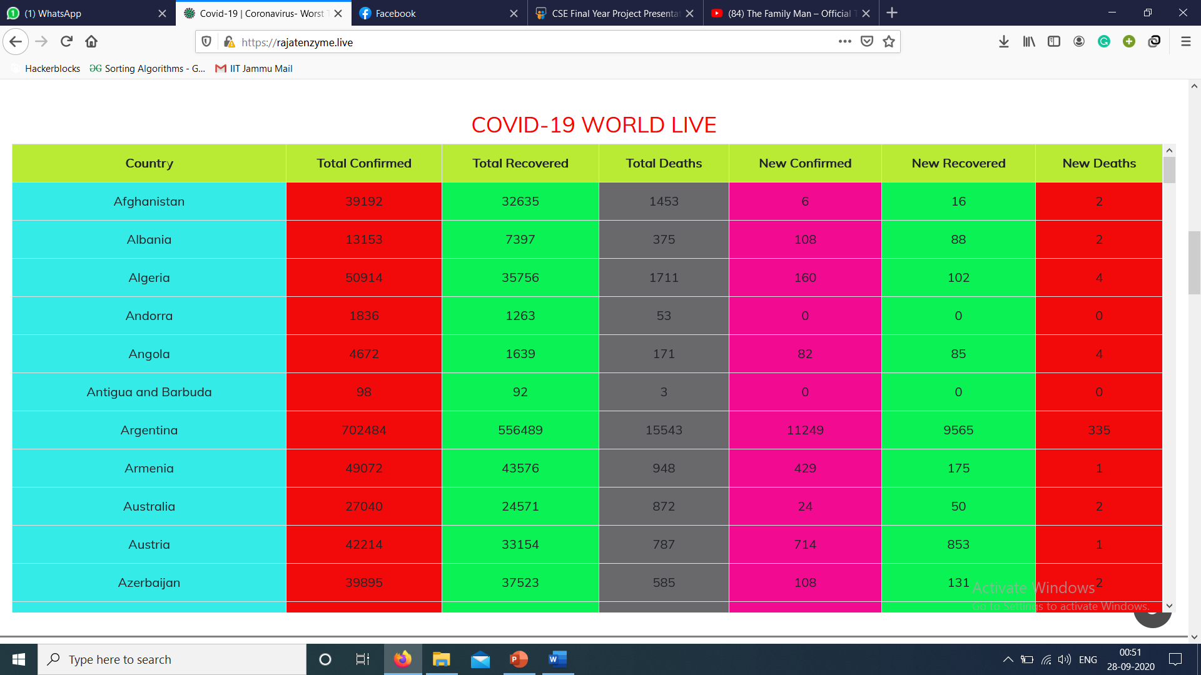
World Live

Slide 10
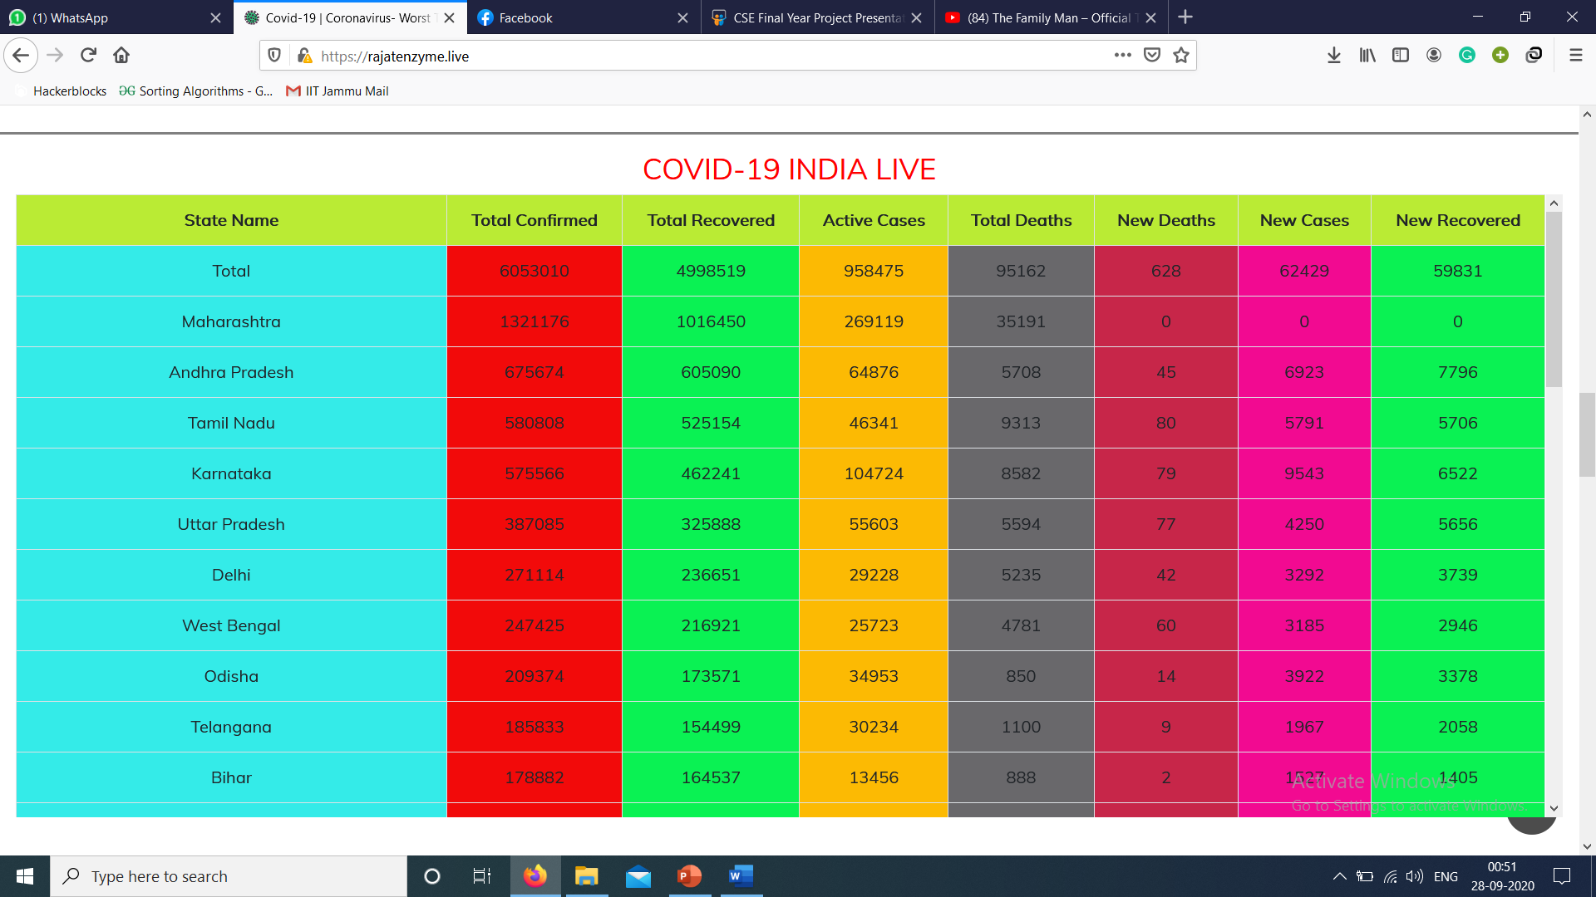
India Live

Slide 11
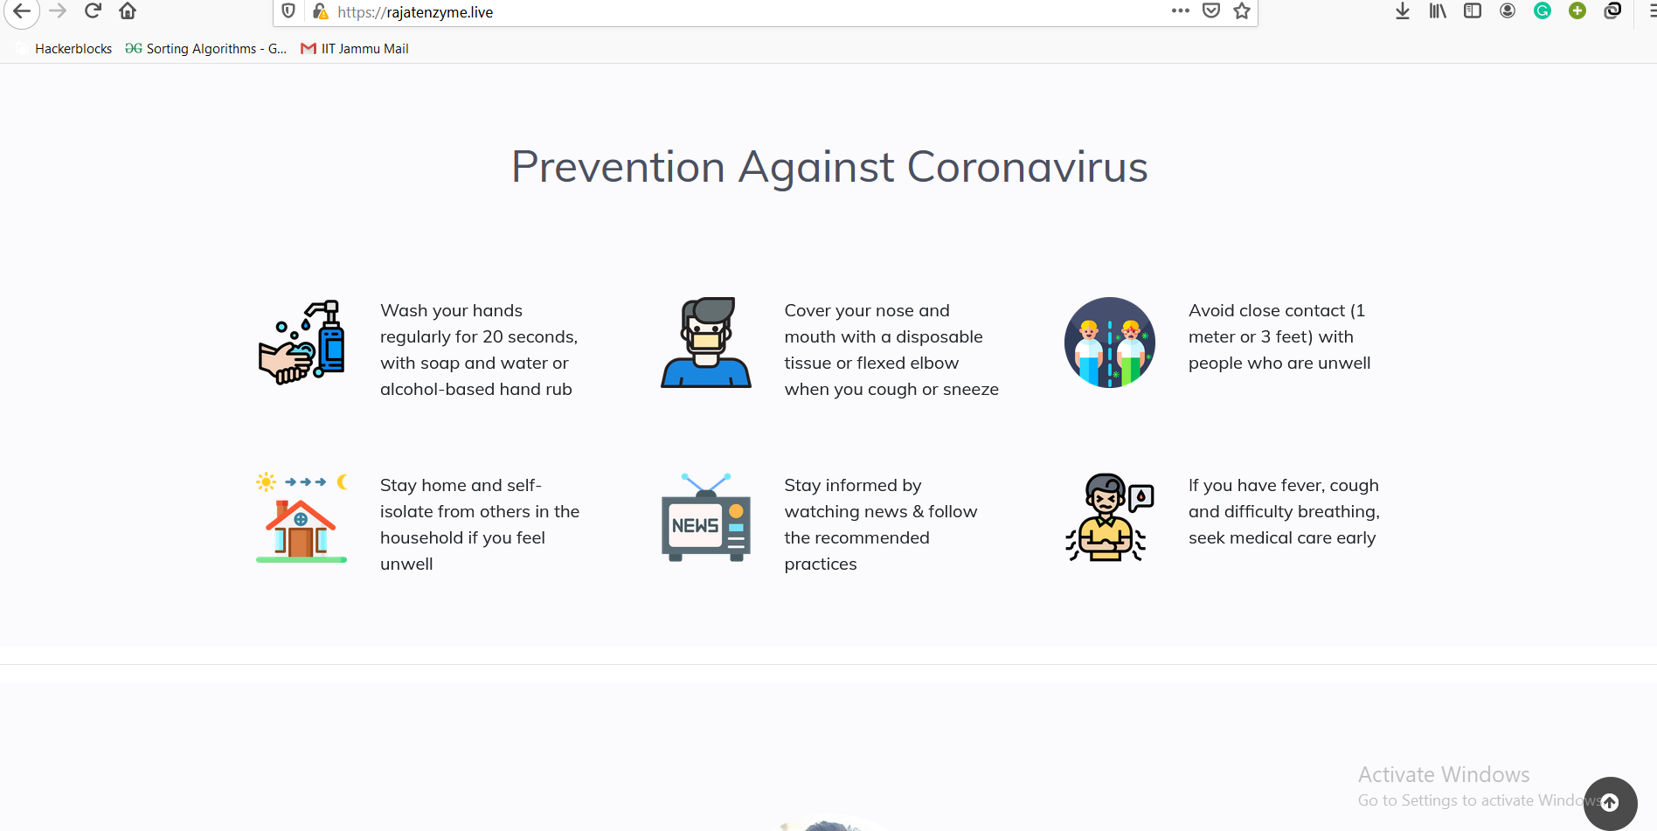
UI

Slide 12
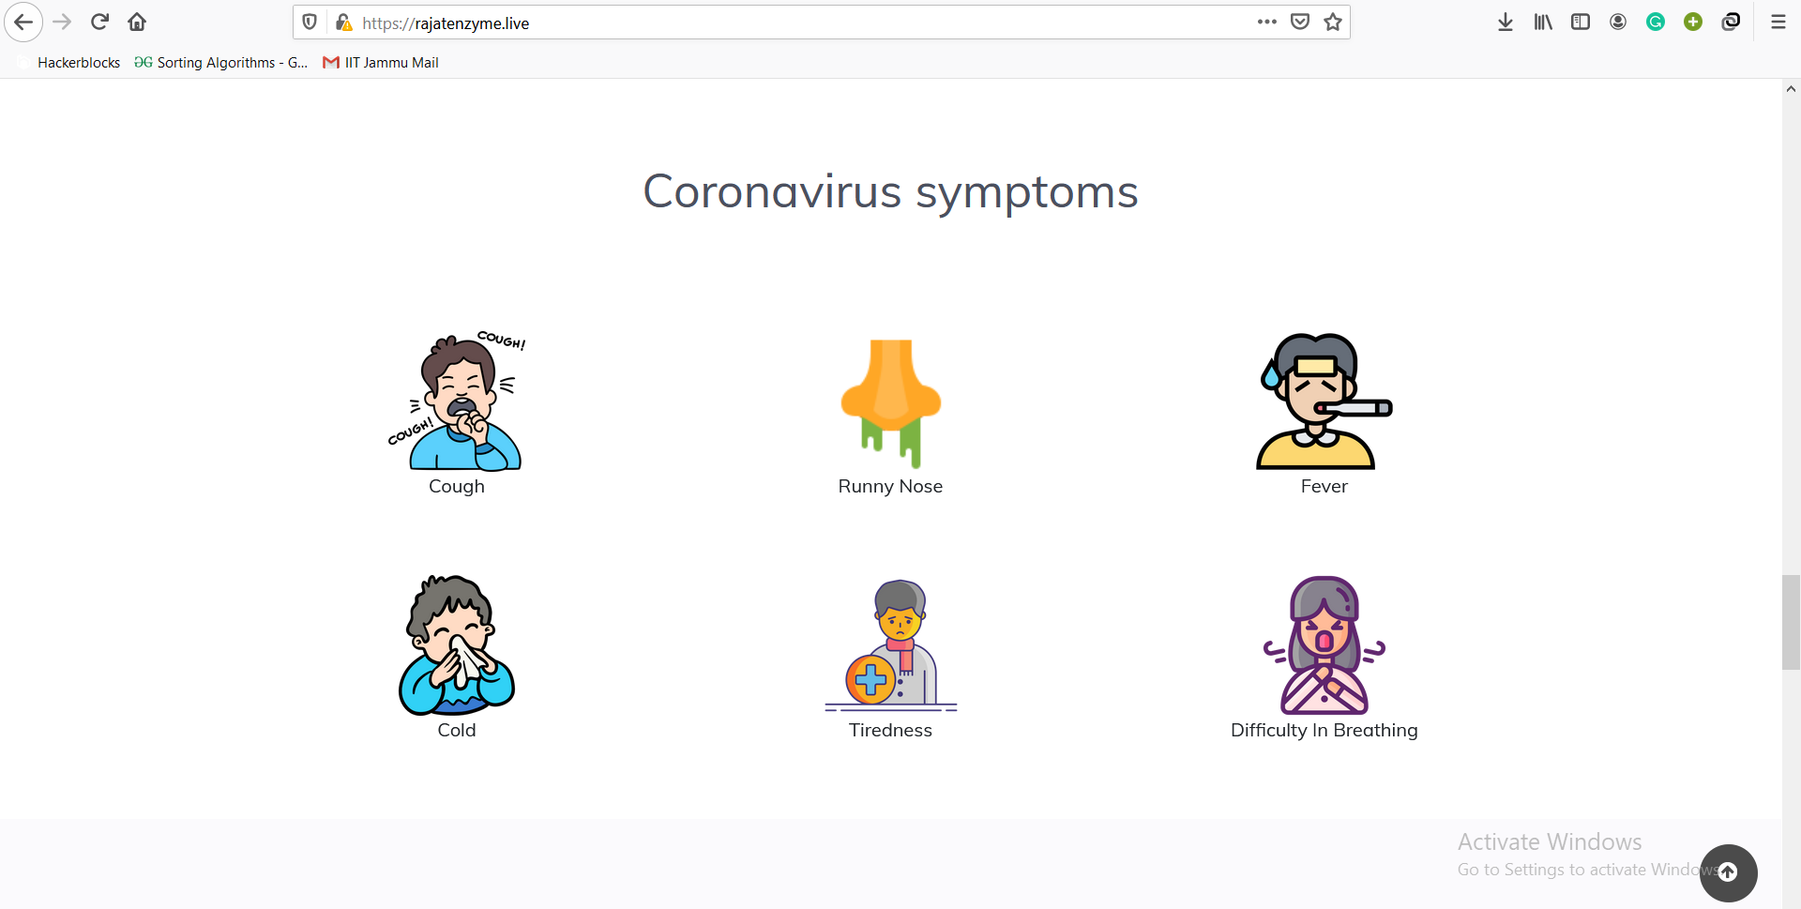
UI

Slide 13
WEBSITE
This project has been hosted on :-
https://rajatenzyme.github.io/covid

Slide 14
Future Work
This project idea can be used for further emergency situations also. Live tracking of anything is always a great idea. This Covid tracker can be further implemented into an app, whatsApp chatbot, Telegram Bot etc. so that illiterate people can also be benefitted.
This idea can also be implemented in Pie-chart, bar-graphs, charts form also for better analytics.

Slide 15
Conclusion
COVID-19 situation is getting worse day by day. I think it is the time to use our technical skills towards our society.

Slide 16
THANK YOU!!

